Slide 1





Mvmgrow.
Startup
Pitch Deck
Presented by Mukesh Prajapat

Slide 2

INTRODUCTION
Hello, my name is Mukesh Prajapat, today I will tell you about my startup Mvmgro which is for those people who buy milk and milk products every morning or evening. We have started this startup by targeting those monthly customers.

Slide 3

Problem
3-5 problems that our company sees and wants to solve.
Problem 1
Problem 2
Problem 3
In today's adulterated era, it is very difficult for people to get natural milk and milk products.
Children and many people do not drink a good healthy thing like milk because it does not taste good.
People not being able to find any third easy source of income along with their work from which they can earn.

Slide 4

SOLUTION 1
MVMGRO Milk Dairy Farm provides you with all natural milk which you can test by visiting our dairy farm or by using the 2 day milk demo product we provide
SOLUTION
SOLUTION 2
Mvmgrow cow milk solves the problems of dairy farm pure cow milk and milk products, good tasty milk product and 3rd simple income source, and many more
For those who do not like to drink healthy things like milk and people who need a special type of ingredient milk product for their health, customized milk products (rose milk, banana milk, almond milk, honey milk, almond milk etc.) etc. are made according to their interest
SOLUTION 3
To give people a third fixed income source, we are integrating 2 level MLM plan in our business which will give people the opportunity to get a third fixed income source every month.

Slide 5

Solution 3 structure & marketing strategy
B*10%=180/month
A
C*5%=90/month
Milk 60rs/L
B
C
C*10%=180/month

Slide 6



Product
or service
Our company manufactures milk and milk related products and delivers them on time.

Slide 7
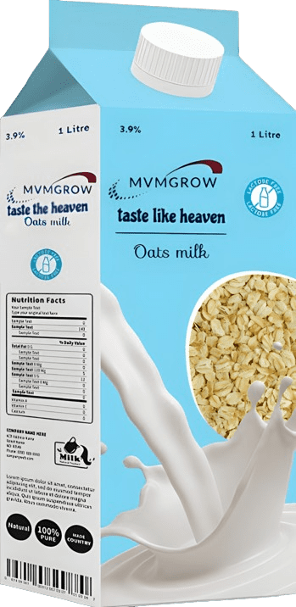
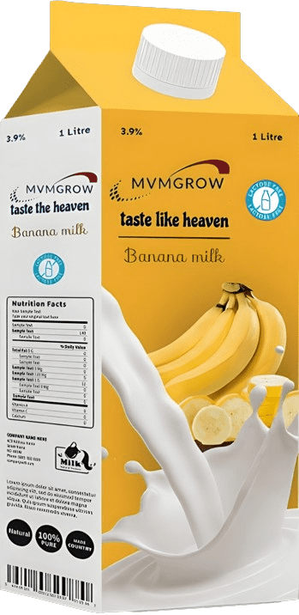
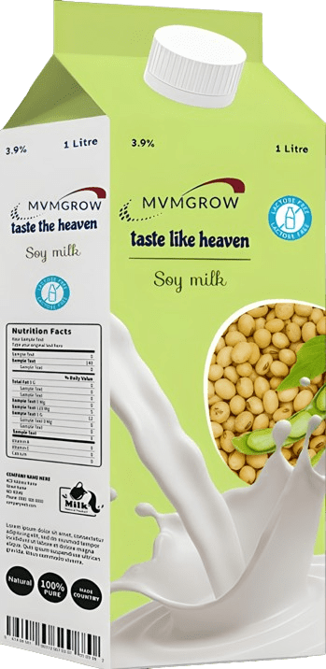
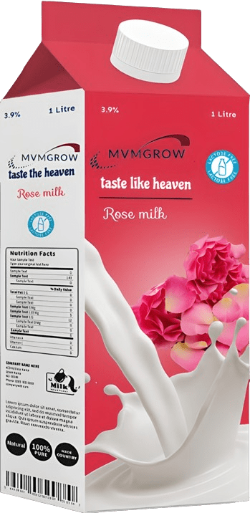
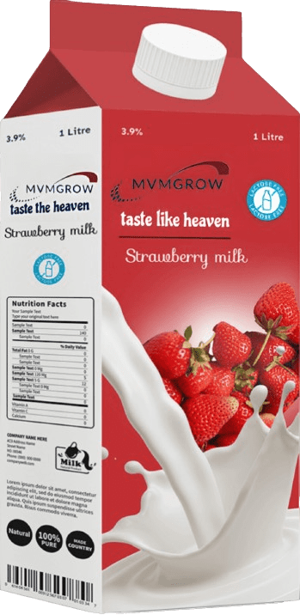
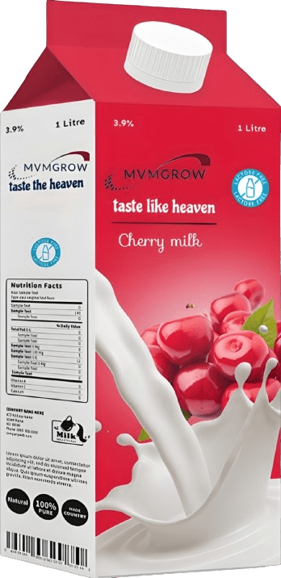
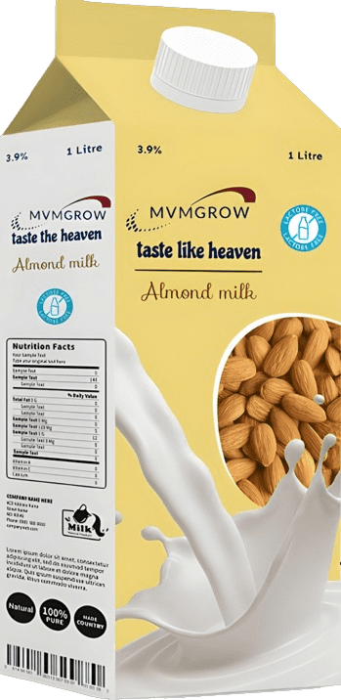
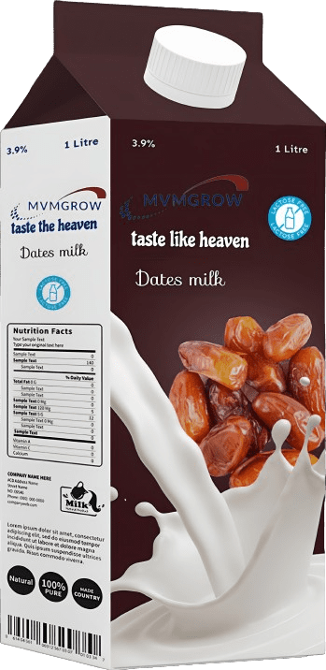
Our product
services
The products are delivered to the customer's doorstep as per the customer's deadline.
Customers can order pure cow milk and customized milk products (monthly based packs) with the help of our website online

Slide 8

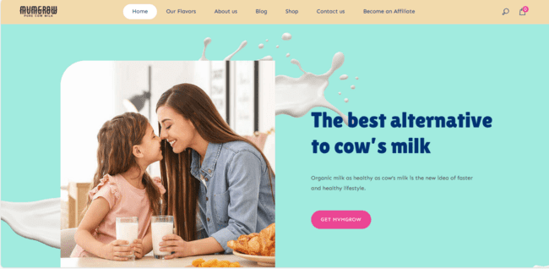

OUR
WEBSITE
Mmvgrow.ezyro.com from where the customer can order online and order cow milk on monthly basis which is delivered daily at the time given by the customer.

Slide 9
Target Market
The customers we want to serve?
Target Market 1
Target Market 2
People who take milk every morning and evening i.e. customers who take milk on monthly plan basis are our first target audience.
People who want delicious healthy customized milk products as per their taste are our second target audience.

Slide 10
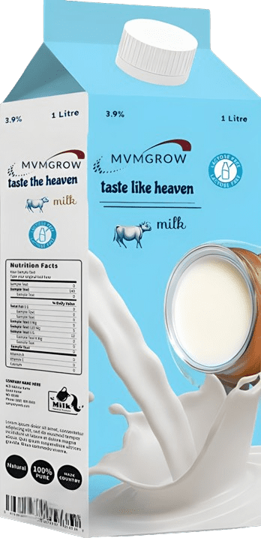
Business or Revenue Model
Show the ways your company plans to make money.
60RS/L
25RS/L
Monthly Profit
PROFIT
TOTAL RENUVE:-
27000*6=189000RS
2 PROFIT:-
189000-13050*6=83700
Monthly Revenue
COUSTMER
15RS
COW EAT
20RS
COW :-15L/DAY
MONTH :-15*30 =450L/MONTH
1 COW REVENUE :- 450*60=27000RS
TOTAL RENUVE:- 27000*6=162000RS
EXPENSES

Slide 11
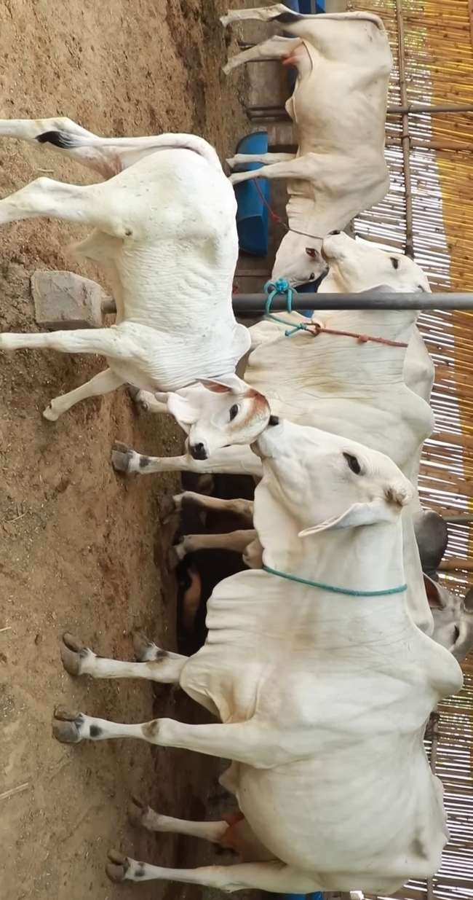
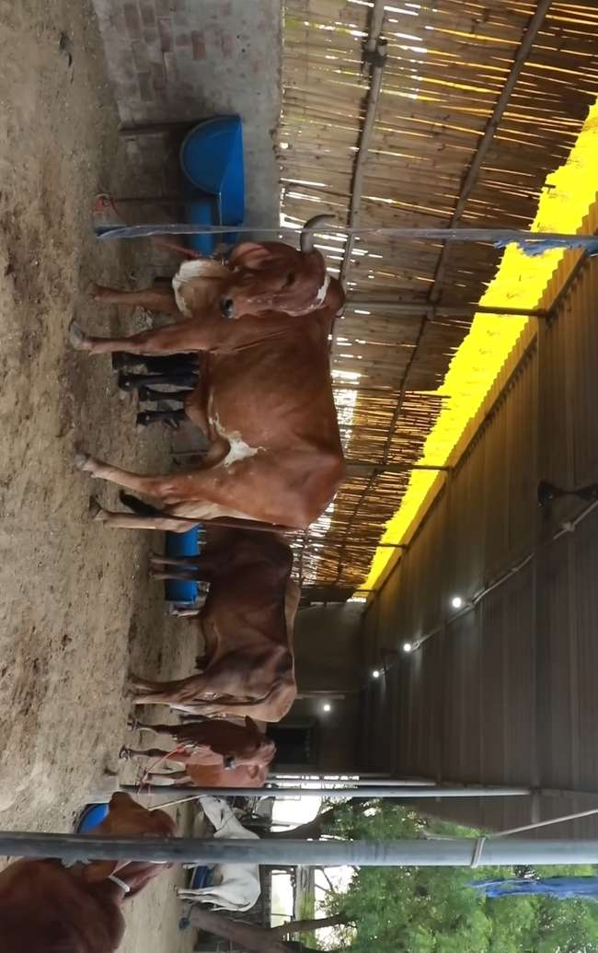
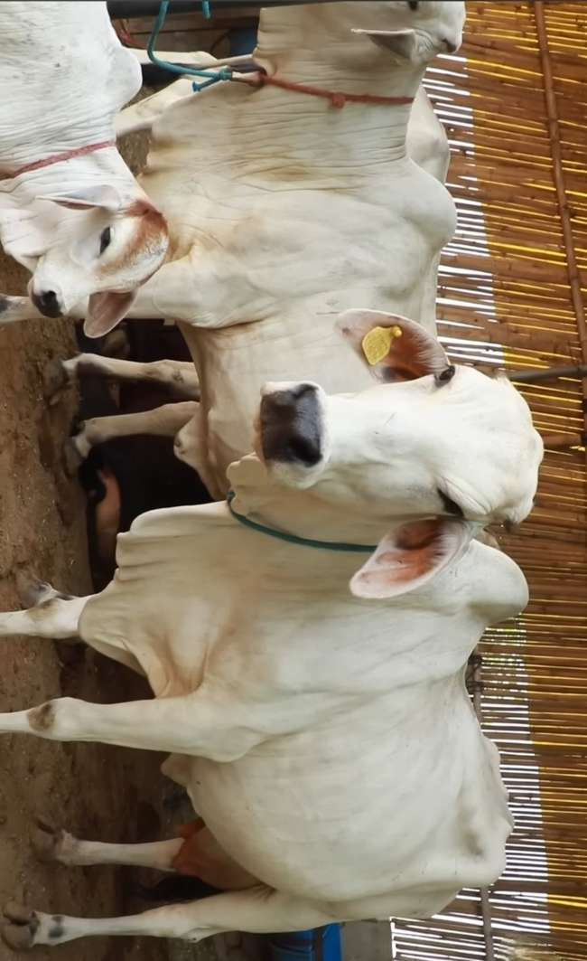
Mvmgrow farm gallery

Slide 12

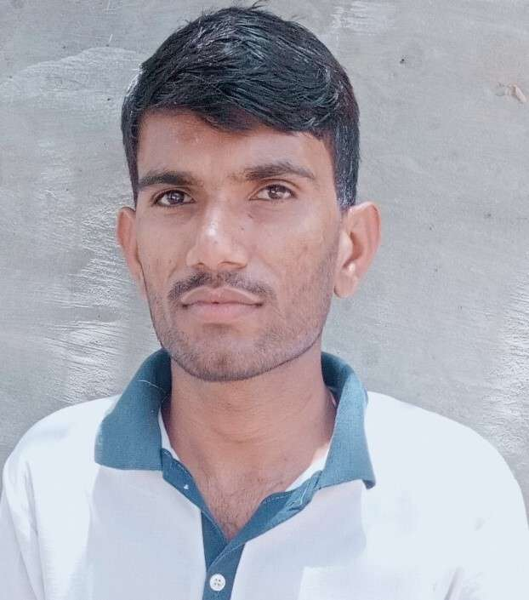
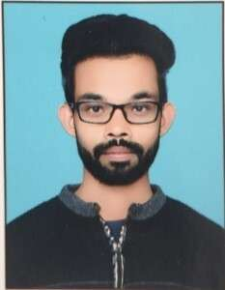
Meet our Team
Mukesh prajapat
Devendar kumar
Vishnu prajapat
Founder
Milk farm care
Accountant

Slide 13


Contact Us
9521045443
mvmgrow@gmail.com
www.mvmgrow.ezyro.com

